Slide 1
IoT-Based Intruder Detection and Alert System
Nirmohi Samirbhai Patel
Pranita Shewale
Bathini Shravan Kumar
CPE -555

Slide 2

Introduction
What is an intruder detection system?
Network of sensors to detect and deter unauthorized entry
Triggers alarms and alerts when triggered
Why implement an IDS?
Physical security for homes and assets
24/7 monitoring capabilities
Rapid notifications of suspicious activity
Remote control/flexible actions through network

Slide 3
Components
NodeMCU Development Board:
Features ESP8266 WiFi SoC
Integrated microcontroller capability
Built-in connectivity for wireless applications
PIR Motion Sensor:
Passive infrared sensor
Detects heat signatures from moving objects
Low power consumption
Easy integration with digital read
Buzzer:
Audio output device
Raises audible alarm on triggered event
Connects to GPIO pins
Loud output with low voltage
Laptop:
Used for programming NodeMCU
Flashing firmware, uploading scripts
Serial monitor for debugging
Notes:
The core component powering this build is the NodeMCU development board featuring the ESP8266 system-on-chip. This tiny WiFi module integrates processing, memory, antenna switches and amplifiers. With its ESP8266 WiFi SoC, integrated microcontroller capabilities, and built-in wireless connectivity, it serves as the brain of our security network. This passive infrared sensor is our keen observer, capable of detecting heat signatures emitted by moving objects. Despite its vigilant surveillance, it operates with minimal power consumption, making it an efficient and essential component of our system. On the output side, the piezo buzzer provides simple alarming capabilities. We configure and program the logic using the IDE.

Slide 4
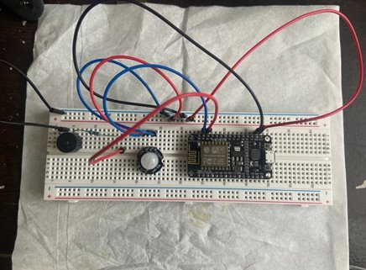
Connections
NodeMCU Development Board
ESP8266 WiFi microcontroller
3.3V power pins
Multiple GPIO pins for wired interfaces
PIR Motion Sensor
Connects to NodeMCU GPIO Pin #1
Provides analog voltage based on motion detection
NodeMCU reads voltage levels to determine intrusion events
Buzzer
Connected to NodeMCU GPIO Pin #2
Activated by sending HIGH output when intrusion
Creates audible alarming
Laptop with IDE via USB
Configures ESP8266 WiFi connectivity
Uploads control scripts to NodeMCU
Serial monitor provides debugging
Notes:
Connecting PIR sensors to a NodeMCU is really simple. The PIR acts as a digital output so all you need to do is operate the pin to flip high (detected) or low (not detected).Power is usually 3-5v DC input.

Slide 5
Block Diagram
Buzzer
PIR Sensor
NodeMCU(ESP8266)
Laptop/Web Page
Programming Tool(IDE)

Slide 6
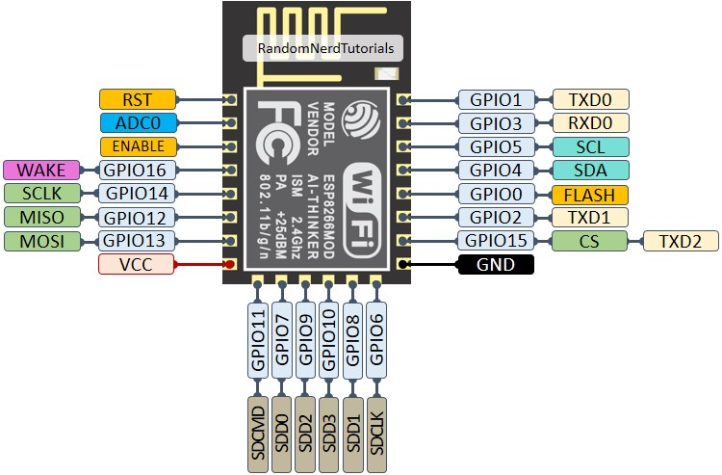
ESP8266 : Heart of the System
Built-in WiFi for wireless connectivity
Low-cost microcontroller with 16 GPIO pins
Flexibility to interface multiple sensors:
PIR for motion sensing
Magnetic sensors for entry points
Vibration and acceleration data
Local processing and threshold detection
Triggers alarms, deterrents on intrusion events
Email/SMS alerts
Sirens and smart lights
Camera activation
Optimized with deep sleep for low power consumption
Mature hardware ecosystem for rapid prototyping

Slide 7
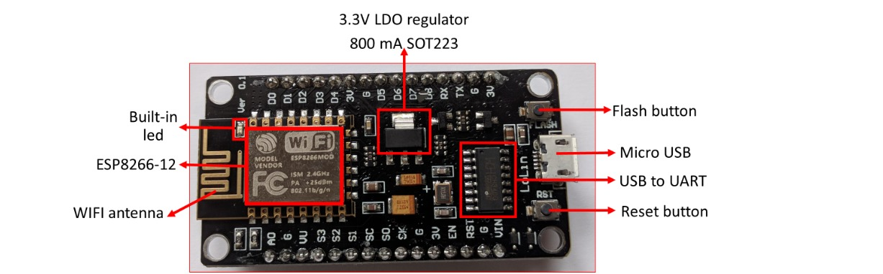
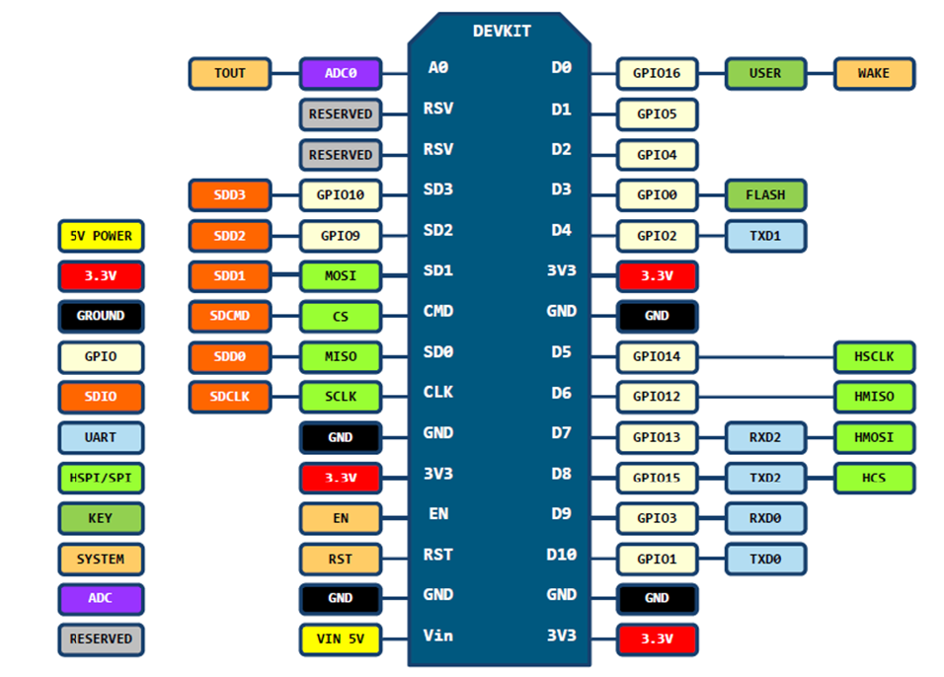
NodeMCU Features
Open-source
Interactive
Programmable
Arduino-like hardware IO
Nodejs style network API
Lowest cost WI-FI
Notes:
Node MCU is development board which has ESP8266 wifi SOC, Along with other peripherals.
Low cost, Simple, Smart, WI-FI enabled

Slide 8
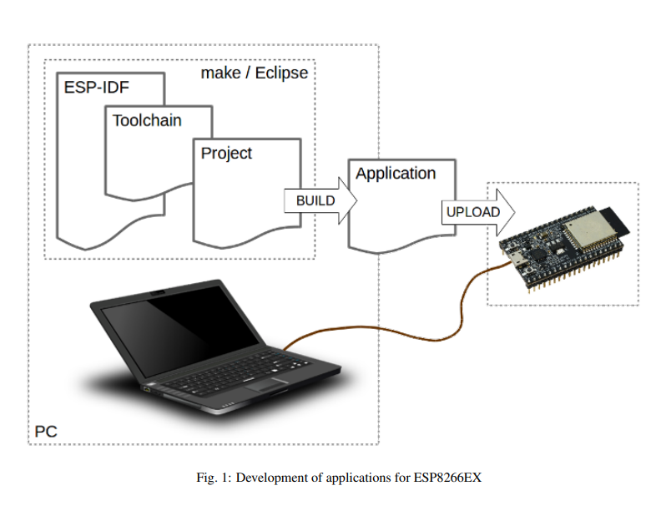
Getting started with NodeMCU
Build the firmware with the modules you need
Flash the firmware to the chip
Upload code to the device.
Notes:
The basic process to get started with NodeMCU consists of the following three steps…..
Preparation of development environment consists of three steps:
Setup of Toolchain
Getting of ESP8266_RTOS_SDK from official site.
Installation and configuration of Eclipse /IDE
Writing code for application, compiling, uploading, monitoring or debugging application

Slide 9

Espressif SDK
Effective APIs for networking functions
Encryption schemes supported for secure communication
Extensively optimized libraries
Drivers for hardware peripherals
Project templates and example projects
Notes:
SDK (Software Development Kit) which has ready-to-compile/ optimized libraries, API, Drivers for hardware peripherals, Project templates and example projects
Recommended Development Environments

Slide 10
What is ESP-AT?
ESP-AT is a project based on ESP8266_RTOS_SDK
Node MCU acts as slave and Microcontroller acts as host
Controller sends AT and ESP chip respond
ESP-AT commands for Wi-Fi, TCP, Bluetooth, HTTP …
Download AT Firmware
Flash AT Firmware into Your Device(ESP Flash Download Tool.)
Check Whether AT Works on serial monitor
Notes:
There are various approach where we can develop appln on node mcu
AT commands

Slide 11
NodeMCU Firmware
Lua based firmware
It is implemented in C
Layered on the Espressif NON-OS SDK
Asynchronous event-driven programming model
Application Code(Lua Script)
Node MCU firmware (C)
ESP8266
SDK
Notes:
2nd approach :
we choose by NodeMCU firmware
NodeMCU is an open-source Lua based firmware for the ESP8266
NodeMCU is implemented in C and is layered on the Espressif NON-OS SDK.
Asynchronous event-driven programming model

Slide 12
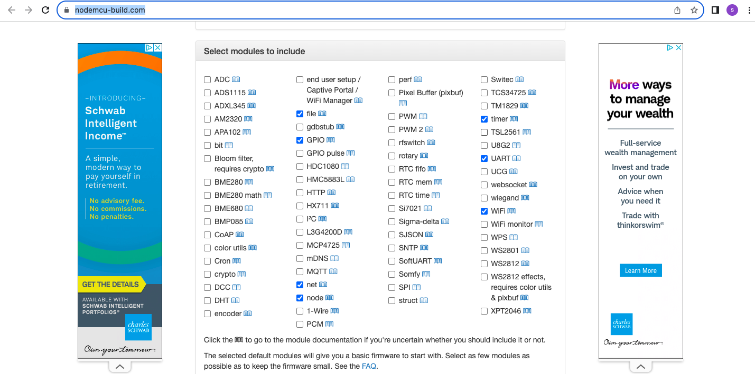
Tools Used

Slide 13
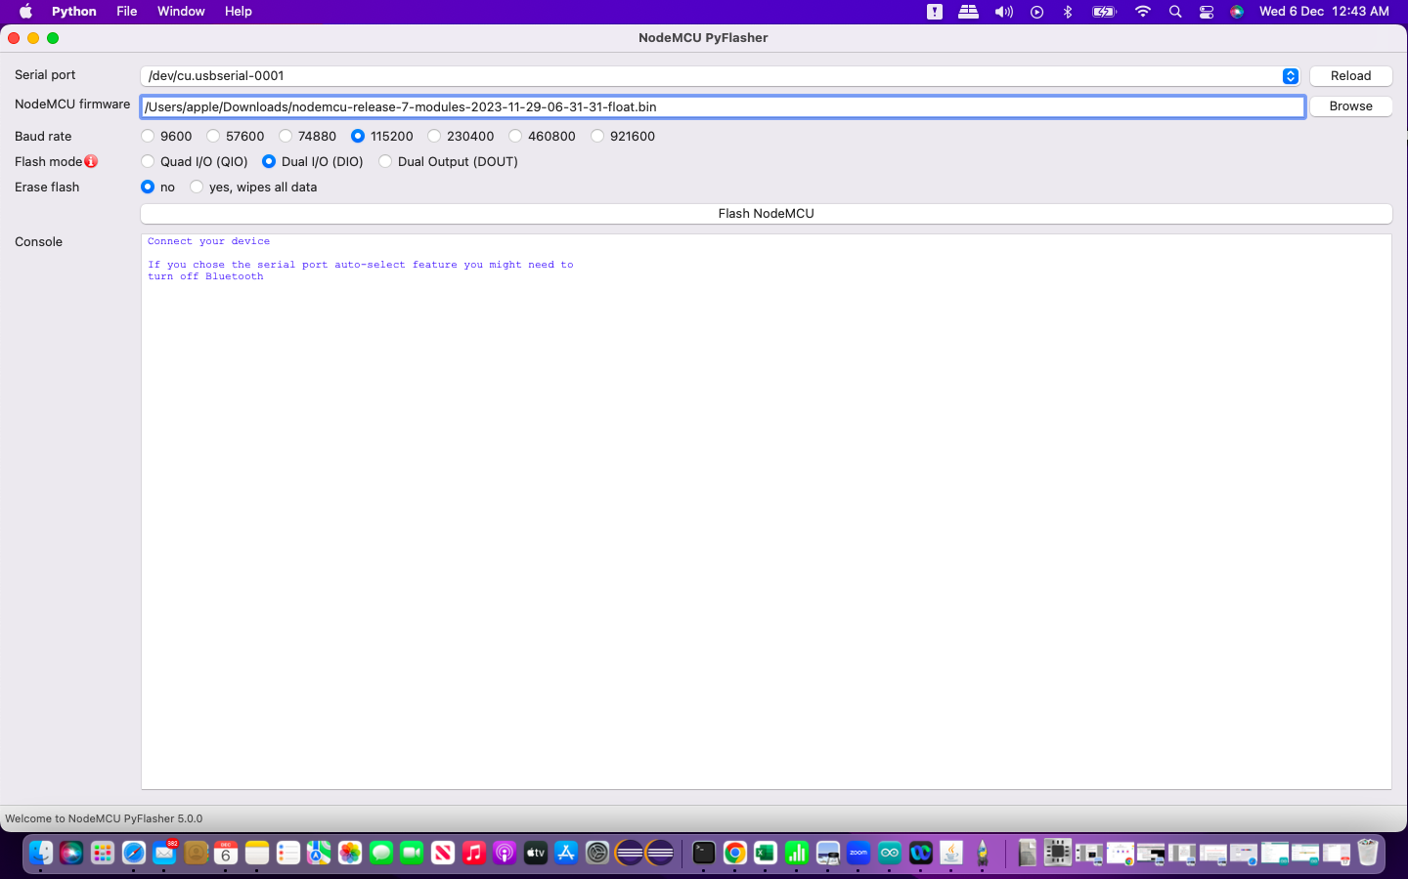
Tools Used 1.NodeMCU PyFlasher

Slide 14
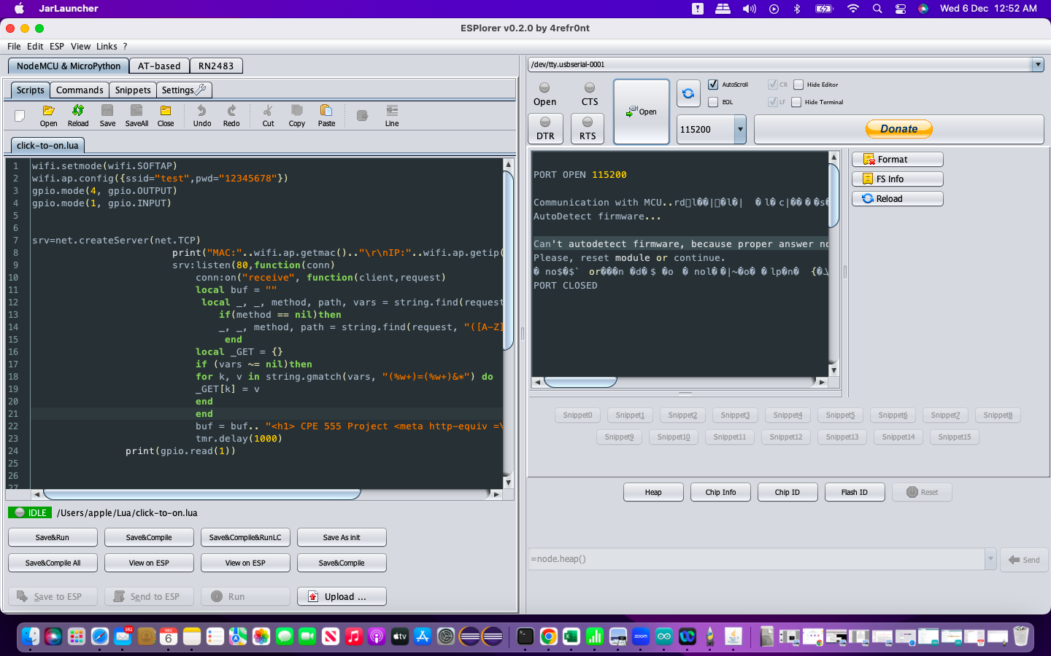
Tools Used 1.ESPlorer
COM port
Open/Close port
Baud rate
Save & Compile
Executing the code on MCU

Slide 15

LUA – Programming Language
Beginner friendly.
Embedded Applications and Game Development.
Simple and efficient

Slide 16
Webserver
HTML script for displaying on the page.
Refreshes data every one second.
Checks the value of the PIR sensor output and displays

Slide 17
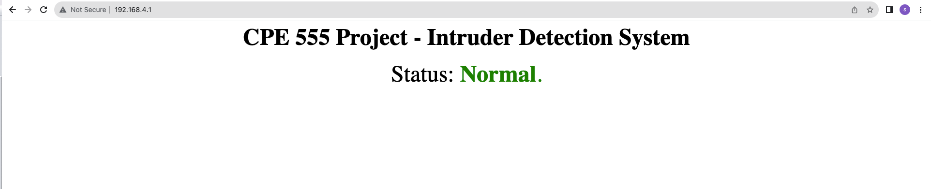
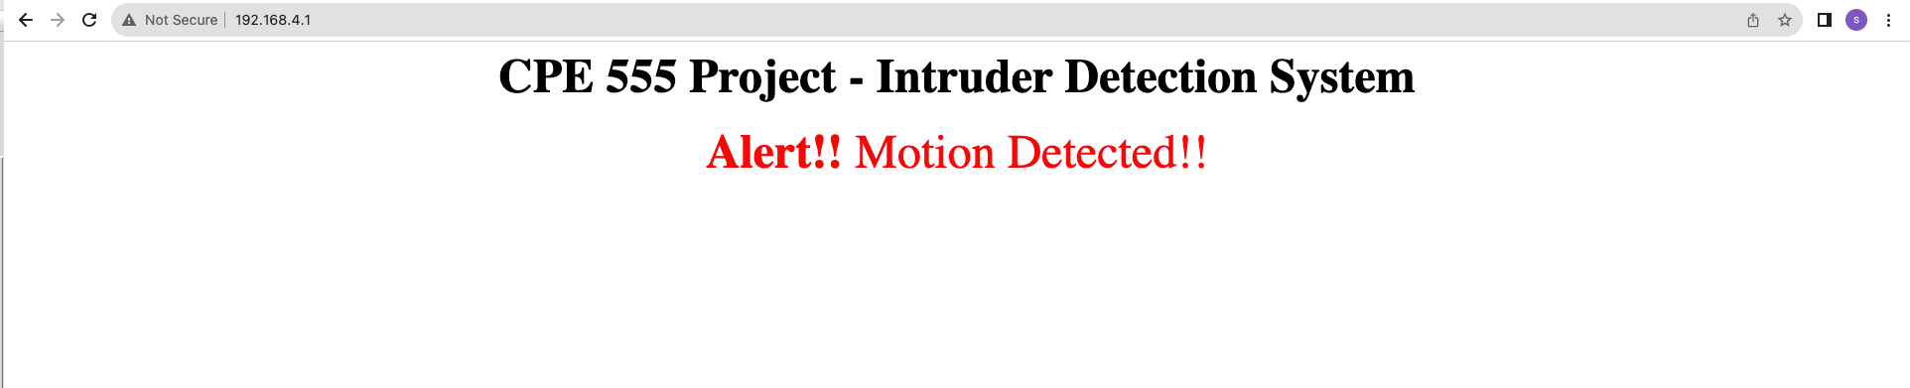
Results

Slide 18
Learning/Challenges
Less resources on NodeMCU using ESPlorer IDE compared to that of Arduino IDE.
New programming language LUA used in embedded applications.
HTML code basics.

Slide 19
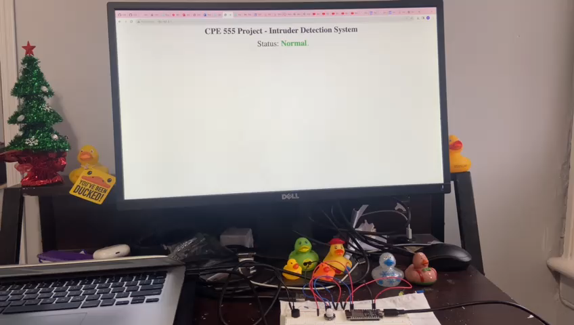
DEMO

Slide 20
Further Scope
Mobile Application Development.
SMS and Call Alerts can be added.
Multi Sensor integration to improve the performance – CCTVs.

Slide 21
References
https://docs.espressif.com/
https://nodemcu.readthedocs.io/en/release/
Saleh Ahmad Khan, Ishtiaq Ahmad, Md. Sazzad Ahmed, Abu Shufian “A Smart Intruder Alert System Based on Microprocessor and Motion Detection,” 2019 International Conference on Robotics, Electrical and Signal Processing Techniques (ICREST).

